Slide 1

PRE-HISTORY OF STS
What is Science/the scientific method?
What is Technology?
How does STS come into this?

Slide 2
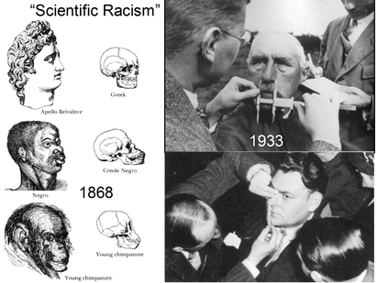
‘Social Darwinism’
Phrenology
Eugenics
Source:
https://www.sahistory.org.za/sites/default/files/4184365.png

Slide 3
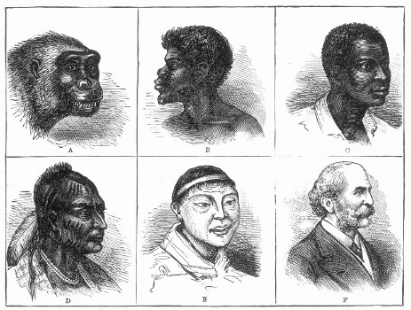
The Science of Race
Example: a 19th century American chart linking evolution and race
Contributors: Natural scientists, Anthropologists, Administrators/Policy-makers
Source:
https://www.facinghistory.org/resource-library/image/nineteenth-century-evolution-chart

Slide 4
THE SECRET OF SCIENCE : STANDARDS & NORMS
1. POSITIVIST ET AL
2. REALIST
3. FUNCTIONALIST
SCIENCE IS ABOUT
1) SUMMARIZING OBSERVATIONS
2) PREDICTING EVENTS ACCURATELY
SCIENCE IS ABOUT PROGRESS TOWARDS TRUTH
1) THE SOCIAL FUNCTION OF SCIENCE IS “THE ACCUMULATION OF CERTIFIABLE KNOWLEDGE” &
2) IT “REWARDS” PEOPLE WHO FOLLOW THIS PRINCIPLE

Slide 5
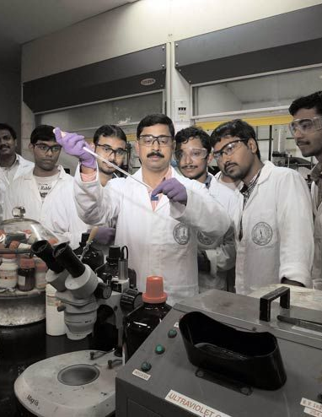
TECHNOLOGY
“…A RELATIVELY STRAIGHTFORWARD APPLICATION OF SCIENCE”?
STS: SCIENCE AND TECHNOLOGY STUDIES
AND
SCIENCE, TECHNOLOGY AND SOCIETY
(SISMONDO, 8- 9)

Slide 6
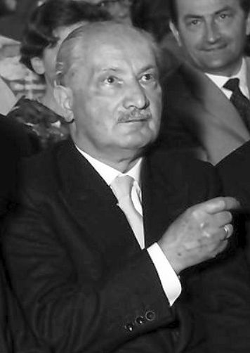
MARTIN HEIDEGGER Philosopher (1889-1976)
MODERN TECHNOLOGY VS TRADITIONAL CRAFT
“OBJECTIFYING” VS “INDIVIDUALIZING”
OBJECTS VS THINGS

Slide 7
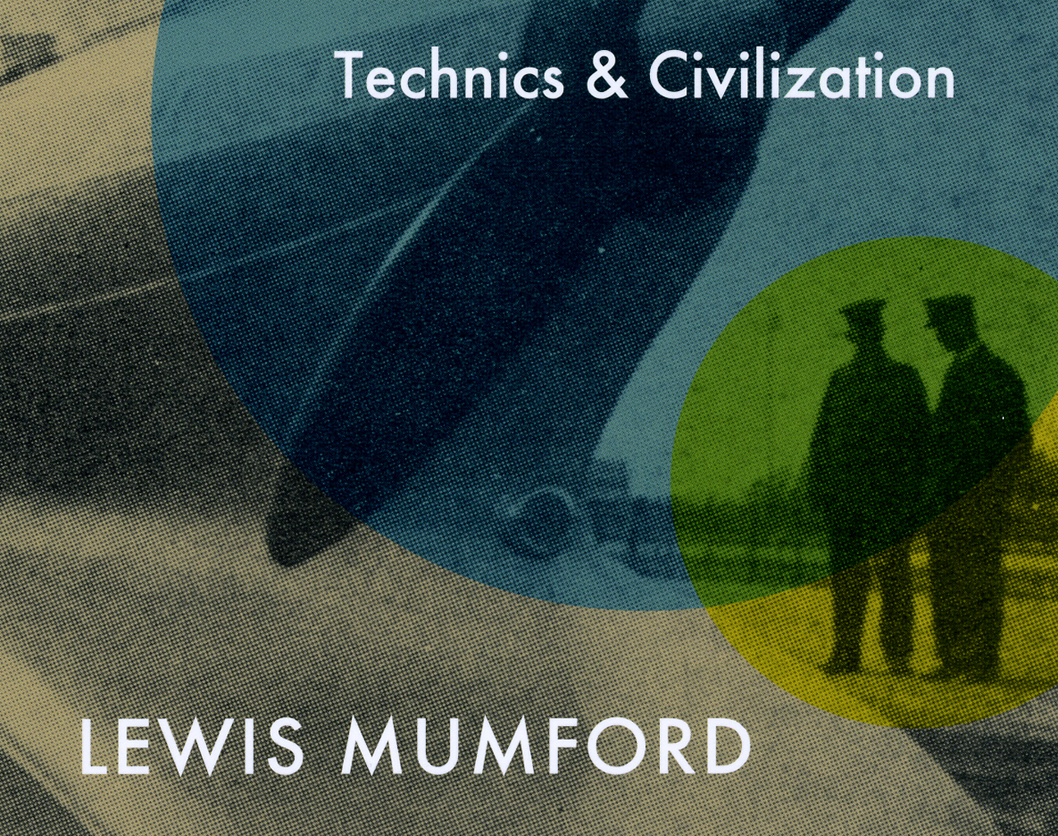
LEWIS MUMFORD Urban Studies (1895-1990)
POLYTECHNICS vs. MONOTECHNICS
“TOOLS OF LIFE” vs. “MEGA MACHINES”
ENABLE HUMAN LIFE vs. “DEHUMANIZING” TECH

Slide 8

SCIENCE AND TECHNOLOGY STUDIES (STS) STARTS FROM AN ASSUMPTION THAT SCIENCE AND TECHNOLOGY ARE THOROUGHLY SOCIAL ACTIVITIES. THEY ARE SOCIAL IN THAT SCIENTISTS AND ENGINEERS ARE ALWAYS MEMBERS OF COMMUNITIES…
IN ADDITION, SCIENCE AND TECHNOLOGY ARE ARENAS IN WHICH RHETORICAL WORK IS CRUCIAL (10- 11)

Slide 9
KEYWORDS
ANTI-ESSENTIALIST
ARTIFACT
PROCESS
SOCIAL CONSTRUCTION (OF KNOWLEDGE, TECHNOLOGY etc.)
MATERIAL WORLD

